Slide 1
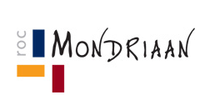
Welcome
G.Z.Sorgucu

Slide 2
Learning Objectives:
Student know the differences between an informal and formal letter
Student knows the format of an informal letter to use
Student can write an introduction of their informal letter

Slide 3

Index
Information for writing
Assignment ( informal writing)
Closing
Time left? Chatterbox.

Slide 4

Think of situations where you have to write in English.

Slide 5
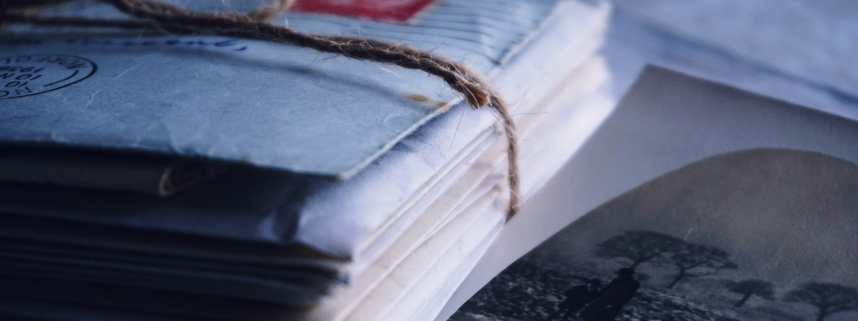
Can you tell the differences between a formal and an informal letter?

Slide 6

A letter is said to be informal when it is written in a friendly manner, to someone you are familiar with.
Formal letters are written for official or professional communication.

Slide 7
 | FORMAL | INFORMAL
Name | Dear Mr/Mrs/Ms Sorgucu Dear Mary | Hi/Hello Sara Sara, …(or no name at all)
Previous Contact | Thank you for your e-mail of.. Further to you last e-mail, … I apologise for not getting in contact with you before now. | Thanks for your e-mail. Re your e-mail, … Sorry, I haven’t written for ages, but I’ve been really busy.
Reason for writing | I am writing in connection with.. I am writing with regard to.. In reply to your e-mail, here are Your name was given to me by.. We would like to point out that.. | Just a short note about.. I’m writing about.. Here’s the … you wanted. I got your name from.. Please note that..
Giving Information | I am writing to let you know that We are able to confirm that.. I am delighted to tell you that.. We regret to inform you that.. | Just a not to say.. We can confirm that.. Good news! Unfortunately..
Attachments | Please find attached my report. I am sending you.. as a pdf file | I’ve attached.. Here is the … you wanted.
Asking for information | Could you give me some information about.. I would like to know.. | Can you tell me a little more about.. I’d like to know..

Slide 8
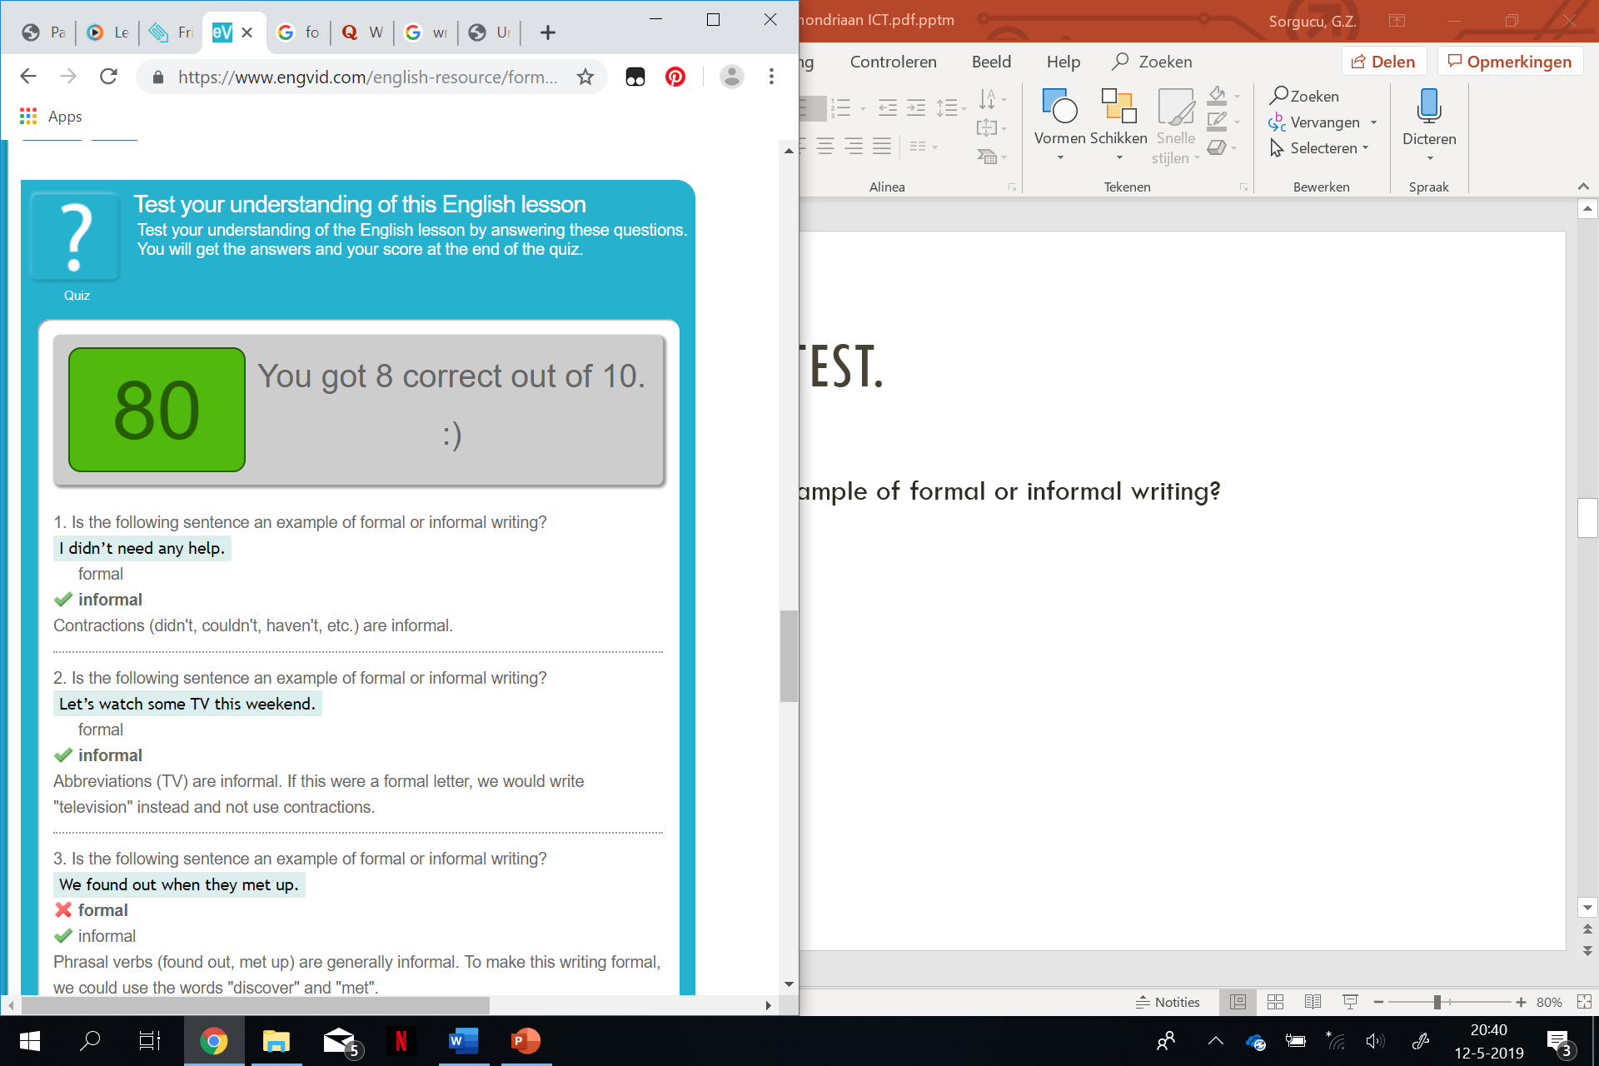
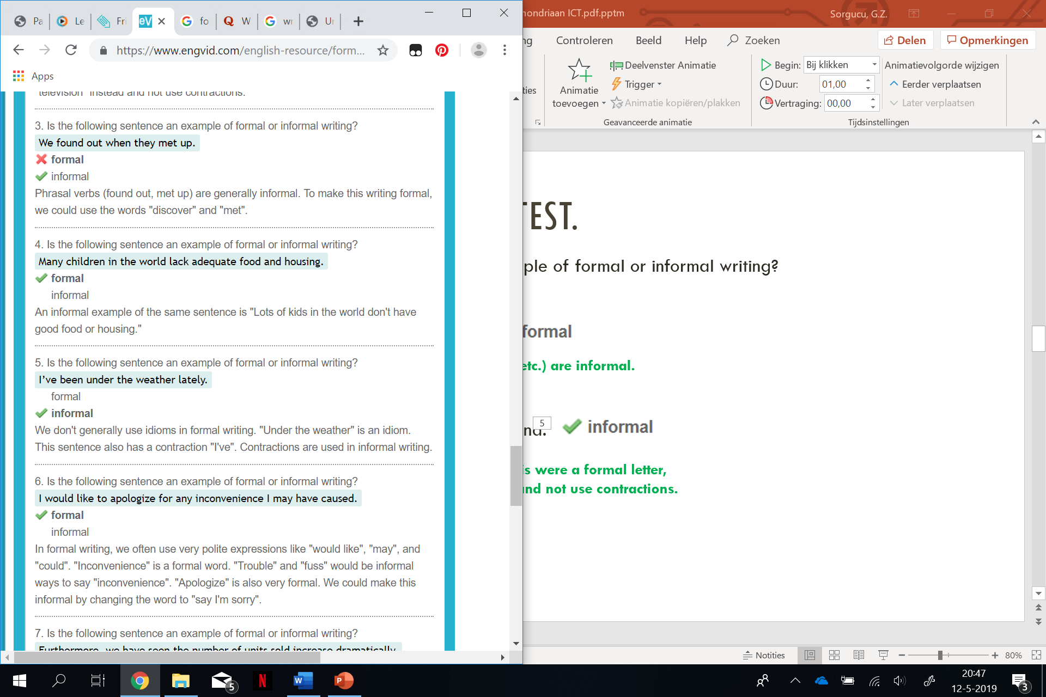
Let’s do a little test.
Is the following sentence an example of formal or informal writing?
1. I didn’t need any help.
2. Let’s watch some TV this weekend.
3. I would like to apologize for any inconvenience I may have caused.
4. Furthermore, we have seen the number of units sold increase dramatically.
Contractions (didn't, couldn't, haven't, etc.) are informal.
Abbreviations (TV) are informal. If this were a formal letter, we would write "television" instead and not use contractions.
In formal writing, we often use very polite expressions like "would like", "may", and "could". "Inconvenience" is a formal word. "Trouble" and "fuss" would be informal ways to say "inconvenience".
"Furthermore" is very formal. We could use "Also" instead to make this sentence less formal.
"Increase dramatically" is formal. We could make this informal by changing this word to "go up a lot"

Slide 9
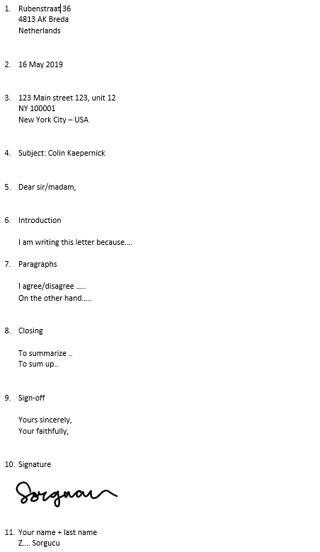
Format Formal
Sender’s address
Date
Recipients address
Subject
Salutation / Greeting
Introduction
Paragraphs
Closing
Sign-off
Signature
Your name

Slide 10
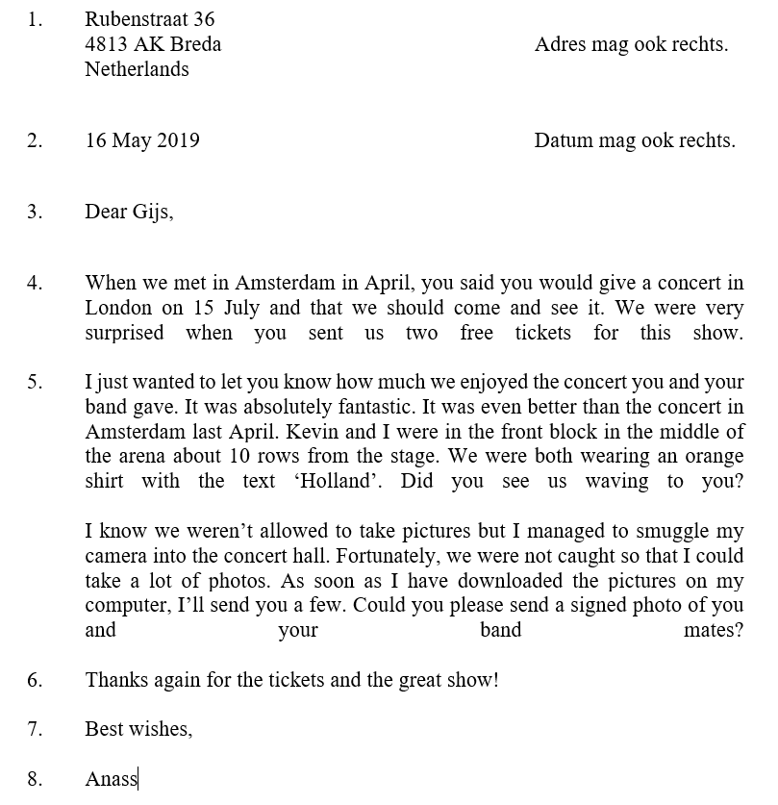
Format Informal
Sender’s address
Date
Salutation / Greeting
Introduction
Paragraphs
Closing line
Ending
Your name

Slide 11
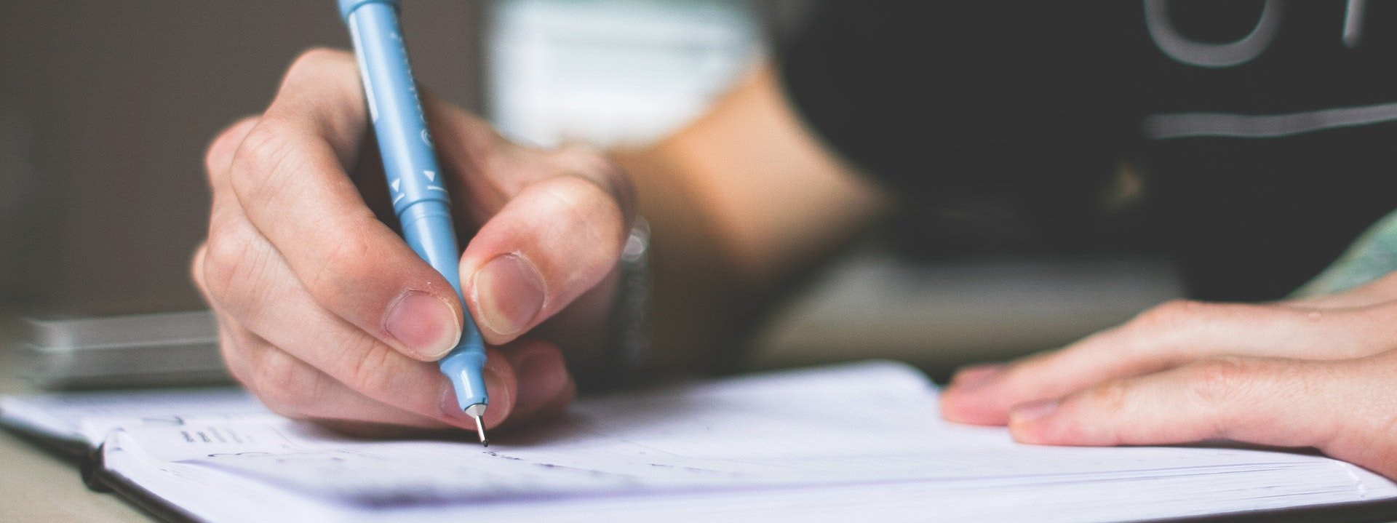
Writing ASSIGNMENT

Slide 12
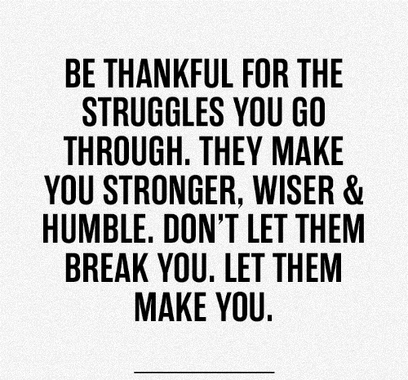
Closing

